Slide 1

Individual Differences
Personality, Values & Diversity

Slide 2
Self Awareness
The degree to which a person is aware of his own behaviors, styles, biases and personality traits.

Slide 3
Components of Self Awareness
Self-concept:
  The view a person hold about oneself. i.e. what kind of person he is physically, spiritually, socially and morally.
Self-esteem:
  A belief of one’s own worth based on an overall evaluation.
Self-efficacy:
  An individual’s belief about the likelihood of successfully completing a specific task.

Slide 4
What is Personality?
The dynamic organization within the individual of those psychophysical systems that determine his unique adjustments to his environment. - Gordon Allport.
  The sum total of ways in which an individual reacts and interacts with others, the measurable traits a person exhibits.
The combination of characteristics or qualities that form an individual's distinctive character.

Slide 5
Measuring Personality
Two dominant frameworks used to describe personality:
  Myers-Briggs Type Indicator (MBTI®)
  Big Five Model

Slide 6
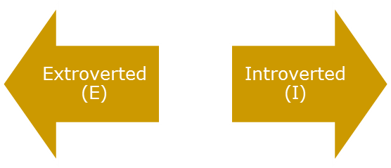
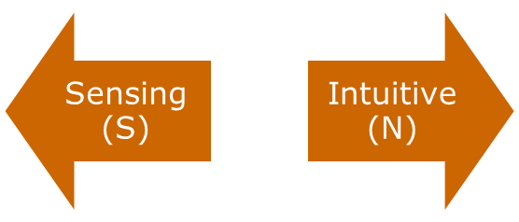
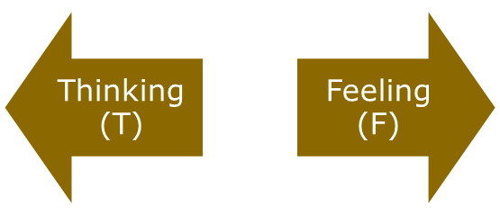
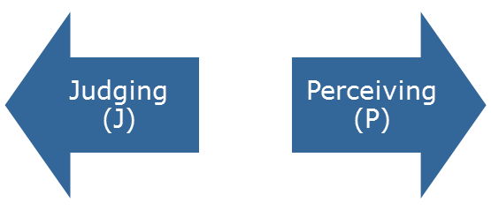
The Myers-Briggs Type Indicator
Most widely used instrument in the world.
Participants are classified on four axes to determine one of 16 possible personality types, such as ENTJ.
Sociable and Assertive
Quiet and Shy
Unconscious
Processes
Practical and
Orderly
Use Reason
and Logic
Uses Values & Emotions
Want Order
& Structure
Flexible and Spontaneous

Slide 7
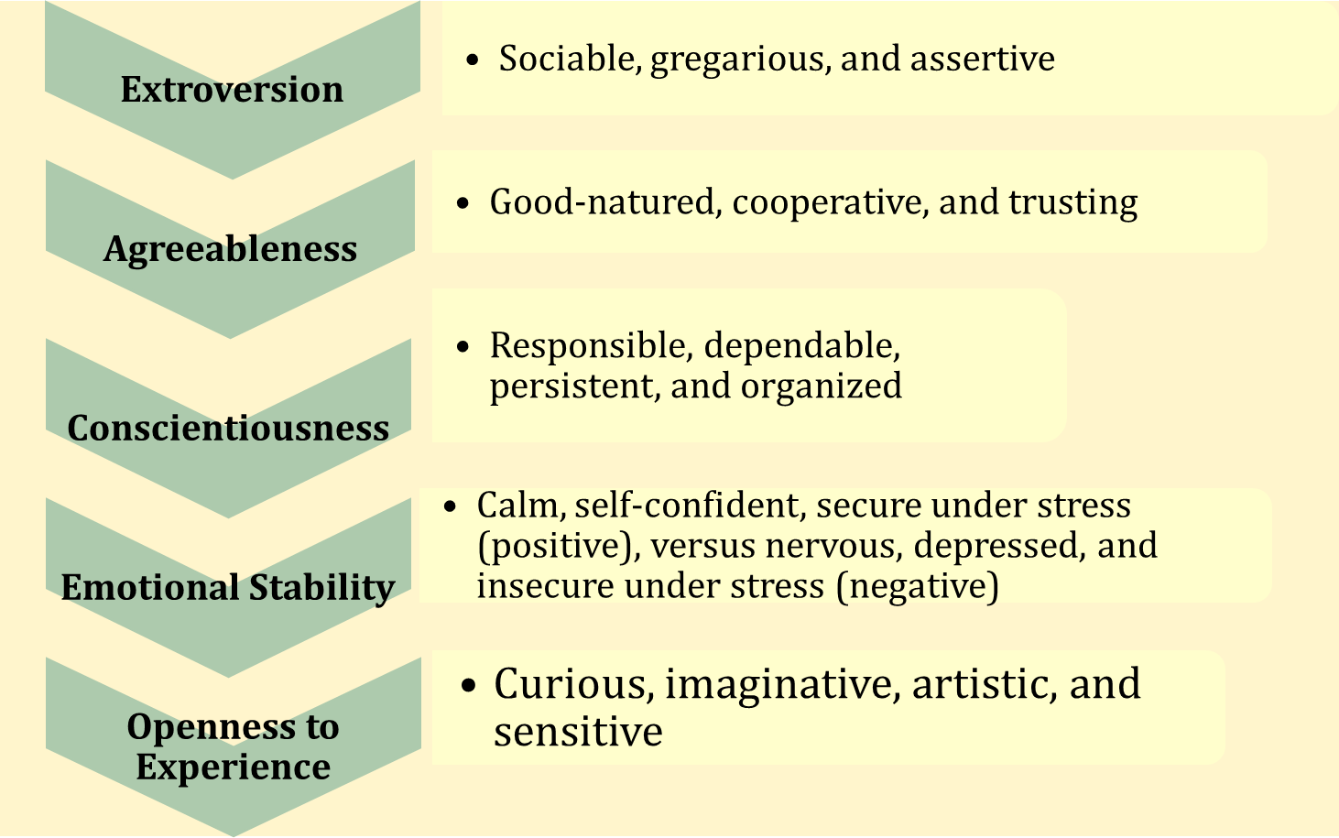
The Big Five Model of Personality Dimensions

Slide 8

Other Personality Traits Relevant to OB
Machiavellianism
  A pragmatic, emotionally distant power-player who believes that ends justify the means.
  High Machs are manipulative, win more often, and persuade more than they are persuaded. Flourish when:
    Have direct interaction
    Work with minimal rules and regulations
    Emotions distract others
Narcissism
  An arrogant, entitled, self-important person who needs excessive admiration.
  Less effective in their jobs.

Slide 9
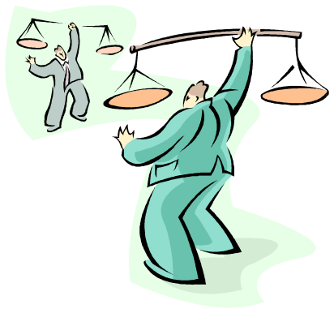
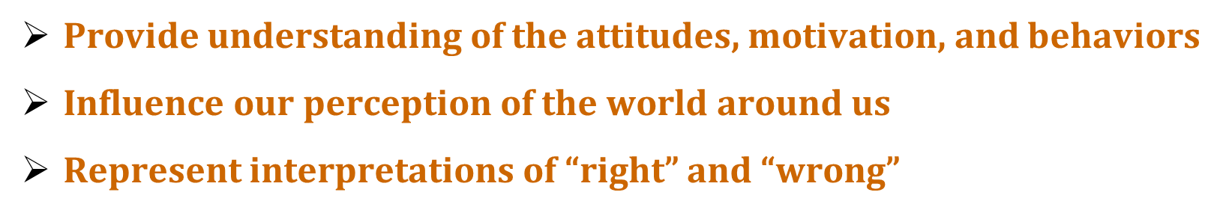
Values
Broad preferences relating to appropriate course of actions or outcomes.
Basic convictions on how to conduct yourself or how to live your life that is personally or socially preferable – “How To” live life properly.
Importance of Values

Slide 10
Classifying Values
Terminal Values
  Desirable end-states of existence; the goals that a person would like to achieve during his or her lifetime
Instrumental Values
  Preferable modes of behavior or means of achieving one’s terminal values

Slide 11
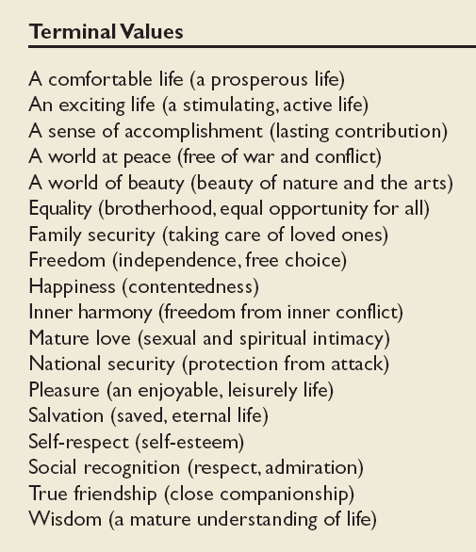
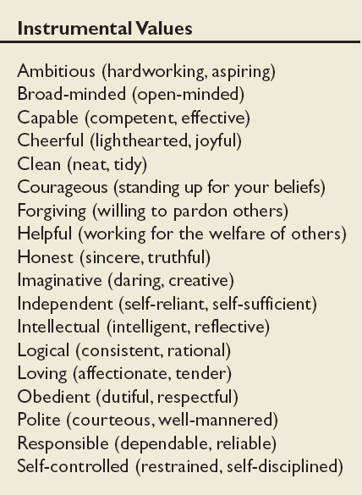
Values in the Rokeach Survey
E X H I B I T 4–3

Slide 12
Values across cultures
Power Distance:
  The extent to which a society accepts that power in institutions and organizations is distributed unequally.
Individualism-Collectivism:
  The tendency of a culture to emphasize either individual or group interests.
Masculinity-Femininity
  The extent to which the society values work roles of achievement, power, and control, and where assertiveness and materialism are also valued

Slide 13
Values across cultures (Continued)
Uncertainty Avoidance:
  The extent to which a society feels threatened by uncertain and ambiguous situations and tries to avoid them
Long-term or short-term Orientation:
  A tendency of culture to emphasize values associated with the future such as thrift, and persistence or values associated with the present.

